Slide 1


Special Service Levy

Slide 2
Agenda
Welcome & Opening Remarks
Purpose of the Meeting
Explanation of the Proposed Special Service Levy
Why are we proposing implementing the Special Service Levy
Questions & Feedback
Next Steps & Closing Remarks

Slide 3
Purpose - Why are we here?
This meeting is an opportunity to:
Explain the proposed Special Service Levy, including how it works and why it’s being introduced.
Show how costs will be distributed and how it impacts taxpayers.
First reading of by-law to pass SSL

Slide 4

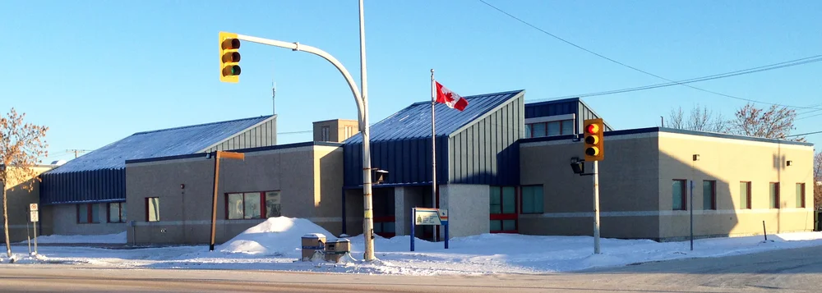
Proposed - 2025 Special Service Levy
RCMP Services
Policing Cost
  $3,208,085 Budgeted 2025
  (2024 = $2,936,280 actual costs)

Slide 5
Exploring - SSL
Approach provides a more fair, transparent, and predictable way to fund policing while supporting potential growth with residential developments, both new builds and upgrades.
Today, policing costs are covered through general taxation, meaning property owners with higher home assessments pay more, even though every property receives the same level of service.
Under the proposed SSL, all eligible properties will contribute equally, aligning costs with the benefits received while supporting growth and potential new development.
fairness – sustainability - development - improved service funding

Slide 6

Municipal Taxation
Mill Rate:
Based on Assessment
Special Service Levy:
Based on actual/budgeted cost
Apportioned equally per property

Slide 7
Taxation Based on Assessment
The municipal mill rate is calculated by dividing the total municipal budget expense requirements by the total assessed value of all properties
Mill Rate = Municipal Budget
Total Assessed Value
x 1000
Each property’s municipal tax is determined by multiplying its assessed value (provincial assessment branch) by the mill rate.
Residential Property Tax = Assessed Value
1000
x Mill Rate
x 45%
Commercial Property Tax = Assessed Value
1000
x Mill Rate
x 65%

Slide 8

Mill Rate Based on Assessment
Taxes Vary Depending on Assessed Value of Property
Reduces the ability to attract individuals or families interested in building or developing single-family homes.
Discourages property improvements by increasing taxes on upgraded homes.
Concentrates the tax burden on higher assessed value homes.

Slide 9
What is a Special Service Levy?
Special Service Levy (SSL) is a municipal tax tool authorized by provincial legislation.
Allows municipalities to apply a fixed charge to designated properties to fund specific services.
SSL supports that all properties receiving the service contribute equally and fairly.
Providing a stable, predictable, and transparent way to distribute costs while supporting development.
A special service levy is NOT a new or additional tax but rather a redistribution of the existing taxes that are collected.

Slide 10
Taxation with Special Service Levy
Residential Property Tax = Assessed Value
1000
Mill Rate
45%
Special Service Levy
Total Special Service Levy (SSL) Value
  $1,056.34 per Residential Tax Roll with <3 dwelling units according to assessment branch.
  All other properties will remain the same, being taxed on assessed value.
Total Reduction in Mill Rate
  2025 Mill Rate: 57.687
  2025 Proposed Mill Rate with SSL: 42.610
This SSL is NOT a new or additional tax
SSL allow for the redistribution of existing tax revenues

Slide 11
Tax Impact Option 1 – Churches excluded
Higher Tax Burden (53%)
Reduced Tax Burden
(47%)

Slide 12



Community Comparisons
Proposed
Flin Flon
Municipal Mill Rate 48.540
Special Service Levy $912.04
(Fire and protective services, recreation, snow removal and dust control)
Taxes on an assessed value of $150,000 = $4,188
Swan River
Municipal Mill Rate 36.004
Special Service Levy $315.33
($860,000 - RCMP Costs)
Taxes on an assessed value of $150,000 = $2,746
Thompson
Municipal Mill Rate 47.351
Special Service Levy $91.91
(Water breaks)
Taxes on an assessed value of $150,000 = $3,288
The Pas
Municipal Mill Rate 42.610
Special Service Levy $1,056.34
(RCMP Cost)
Taxes on an assessed value of $150,000 = $3,933

Slide 13
Frequently Asked Questions - Info
FAQ - Hand Out
Future information will be posted on Town of The Pas Website – www.townofthepas.ca
Call the Office – 204-627-1100

Slide 14


Slide 15
From here - what is next?
Sept 22nd, 2025 – Hold Public Hearing
  First reading of SSL Bylaw
  Provide 14 days to allow for a formal written objection to TOTP. These must include the following
    a statement of the person's objection to the proposed by-law;
    the name and address of the person;
    identification of the parcel of land in respect of which the objection is made; and
    the person's signature
Oct 6th, 2025: Objection Period Ends
Council Review Information & Makes Decision
If passed, this will come into effect with the 2026 budget
If there are 25+ formal objections, the matter goes to the Manitoba Municipal Board.

